Slide 1

Common Citation Errors
Law Review Editor Training

Slide 2
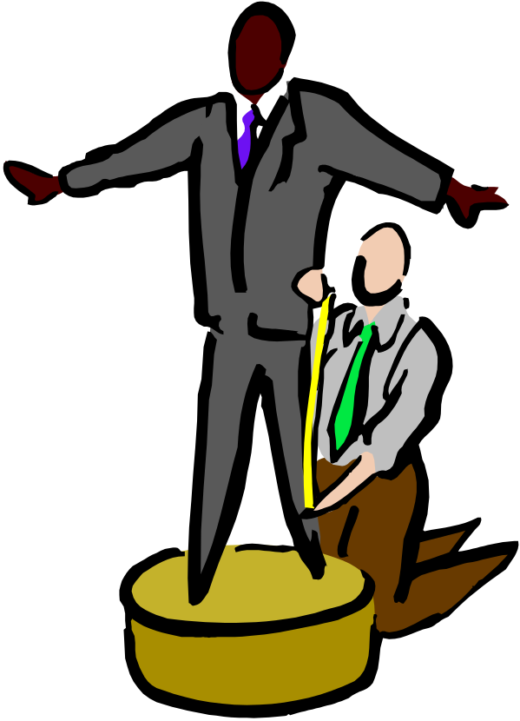
Spacing
ALWD Rule 2.
Triangles = space.
Use the Appendices.
Specific errors:
  S. 2d
  F. Supp.2d
  §2704
  § 2704 (a)

Slide 3
Typeface within Text
In textual material, the following should appear in italics:
  Case names
  Names of publications (such as book titles and names of legal periodicals, including names of newspapers and law reviews)
Do not italicize:
  Statutes or court rules
  Names of reporters

Slide 4
En-dashes and Hyphens
Use an en-dash, not a hyphen, to indicate a span.
  352–354
  Not: 352-354
An en-dash (–) is longer than a hyphen (-).
Read to make sure that hyphens have not been changed to en-dashes.
  Example: First–degree burglary, instead of first-degree burglary.

Slide 5
Commas
If a citation appears in a citation clause, place a comma at the end of the citation.
  One court held for the defendant, Smith v. Jones, 19 F.3d 288, 291 (2d Cir. 1998), but the other held for the prosecution, Reynolds v. Carter, 21 F.3d 346, 350 (3d Cir. 1998).
Supra citations:
  Supra n. 5, at 27.
  Not: Supra n.5 at 27.

Slide 6
Short Citations for
Articles and Books
Rules 22.2, 23.2 and 11.4
Correct short form (other than id.):
  Nguyen, supra n. 44, at 54.
  Not: Nguyen, Torts Update, supra n. 44, at 54.
Hereinafter:
  Use sparingly. Make sure you use it again.
  Short form typeface:
    Loser Calls for Election Recount in Mayoral Race, 44 St. Pete. Times 1A, 1A (Nov. 9, 2000) [hereinafter Election Recount].

Slide 7

Signals and Parentheticals
If the author uses a signal, it often helps, but is not required that, the citation include an explanatory parenthetical or an explanatory sentence.
E.g. alone does not require a parenthetical.

Slide 8
Capitalization
Rule 3.
Do not capitalize prepositions in titles (unless the first word in title or subtitle).
  See the new chart in Rule 3.
Always capitalize verbs, nouns, adverbs, and adjectives.

Slide 9

Order of Authorities
Use the general and specific rules in ALWD Rule 46.
If you see multiple sources, always check order.
“Id.” problem.
Bluebook is different.

Slide 10

Quotations
Accuracy
Introduction
Omissions
Alterations

Slide 11

Consistency Issues
Short forms.
Capitalization.
Spelling.
Everything else.
Read in a large block of time.

Slide 12
Find the errors
Jack Nicholson starred in One Flew Over the Cuckoo’s Nest.
See supra note 17 at 23.
Smith v. Reynolds, 452 F. Supp.2d 114, 115-117 (S.D. N.Y. 2000).
Niederman, Computer Hackers, supra n. 14, at §3-1, 78.

Slide 13
ALWD-Bluebook
“Selected” Differences
No large and small caps
Full case names are italicized
Insert volume numbers for periodicals
Different form for nonconsecutively paginated legal periodicals
Use all digits on page spans
Insert publishers for books
Order of authorities
Signals
Abbreviations with apostrophes

